Slide 1
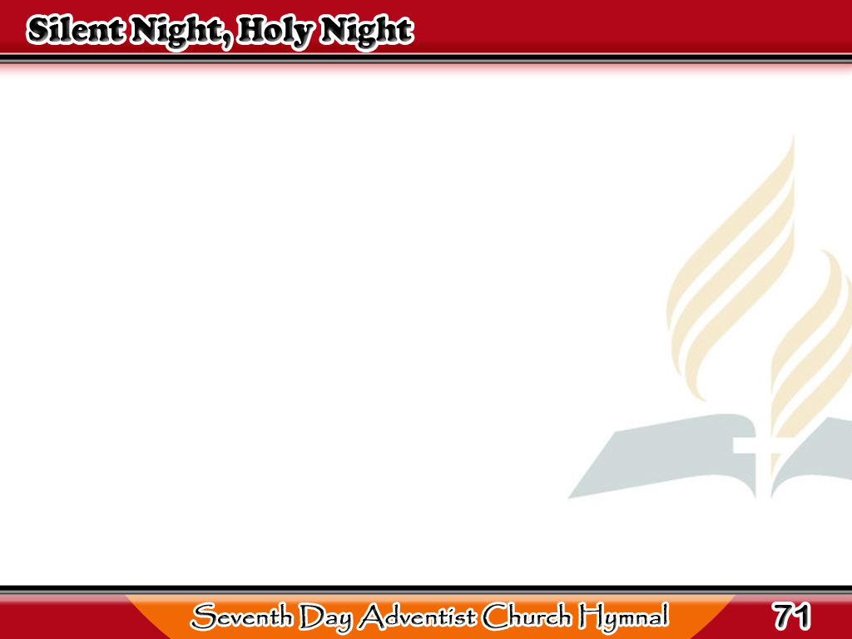
Tahimik ang Gabi
Silent night, holy night,
All is calm, all is bright;
Round your virgin mother
and Child!
1/4

Slide 2
Tahimik ang Gabi
Holy Infant,
so tender and mild,
Sleep in heavenly peace,
Sleep in heavenly peace.
1/4

Slide 3
Tahimik ang Gabi
Silent night, holy night,
Darkness flies, all is light;
Shepherds hear the
angels sing,
2/4

Slide 4
Tahimik ang Gabi
“Alleluia! Hail the King!
Christ the Savior is born,
Christ the Savior is born.”
2/4

Slide 5
Tahimik ang Gabi
Silent night, holy night,
Son of God, Love’s pure light;
Radiant beams
from Thy holy face,
3/4

Slide 6
Tahimik ang Gabi
With the dawn
of redeeming grace,
Jesus, Lord, at Thy birth,
Jesus, Lord, at Thy birth.
3/4

Slide 7
Tahimik ang Gabi
Silent night, holy night,
Wondrous star, lend thy light;
With the angels let us sing,
4/4

Slide 8
Tahimik ang Gabi
Alleluia to our King;
Christ the Savior is born,
Christ the Savior is born.
4/4

